Slide 1


MOBILE TRACKING SYSTEM
SUPERVISOR Mrs.K.ValliPriyadharshiniM.E., AP/CSE.
PRESENTED BY
2303811710421157 – SRINIVAS R

Slide 2

PRESENTATION OVERVIEW
Objective
Project Introduction
Problem Statement
Methodologies (Programming concepts relevant to problem statement)
Architecture of the proposed system
List of Modules
7. Merits
8. Results and Discussion
9. Queries

Slide 3
OBJECTIVE
The objective of the mobile tracking system to help find location of device when it is missing and use to secure the device when it need.
Enter user details
Track mobile
Lock device
Exit.

Slide 4
PROJECT INTRODUCTION
Mobile phones have become an essential part of our daily lives.
The risk of losing or having a phone stolen has increased with the growing number of mobile phone users.
A mobile tracking system can be employed to locate and recover lost or stolen mobile phones.
The Mobile Tracking System project aims to design and develop a basic system that can track the location of a mobile phone using its IMEI number.
The system will simulate the tracking process, providing the user with the location details of the mobile phone.
This project demonstrates a simple implementation of a mobile tracking system, highlighting its potential benefits and applications.
.

Slide 5
PROBLEM STATEMENT
In mobile tracking system there is not efficient to track our device when it is lost or stolen .
To efficiently locate and secure device when it’s need.
1.Innacurate Mobile Location
2.No validation for user details input
3.Lock of security in locking
4.User detail dependencyTo achieve this steps to get a efficient mobile tracking system.

Slide 6
Methodologies (Programming concepts relevant to problem statement)
1. Classes: The project uses a class MobileTrackingSystemAWT to encapsulate the data and methods.
2. Objects: Instances of the class are created to use its methods and attributes.
3. Inheritance: The project uses inheritance by extending the Frame class.
4. Polymorphism: The project uses method overriding to provide different implementations of methods.
5. Encapsulation: The project encapsulates data and methods within the class.
Java Concepts:
1. AWT (Abstract Window Toolkit): The project uses AWT to create the graphical user interface (GUI).
2. Event Handling: The project uses event handling to respond to user interactions.
3. Random Number Generation: The project uses random number generation to simulate the location of the mobile device.
4. String Manipulation: The project uses string manipulation to handle user input and display output.

Slide 7
FLOW DIAGRAM
User Interface
User details
Tracking mobile
Lock the device
Exit
1.Mobile no
2.Mobile ID
3.IMEI NO
Track your device
Which it’s located
In district and area
To lock the device for secure the device

Slide 8
MODULE DESCRIPTION
1.User detail validation
The program user details like Mobile number,Mobile ID,and IMEI number to be provided
before accessing key feaures like tracking.
2.Randomized location tracking
The program simulates mobile tracking by user details to fetch the location.
3.Device locking simulation
The program provides a basic simulation of a “Lock device” feature for securing purpose.
4.Exit option and loop control
The program is designed to continuously present the user details with fetch location
So it will be end using exit option.

Slide 9
MERITS
Use the IMEI number to track the location of the mobile device.
Display the location of the mobile device on the user interface.
Allow users to lock their mobile device remotely.
Send a lock command to the mobile device.
Display a success message on the user interface.

Slide 10
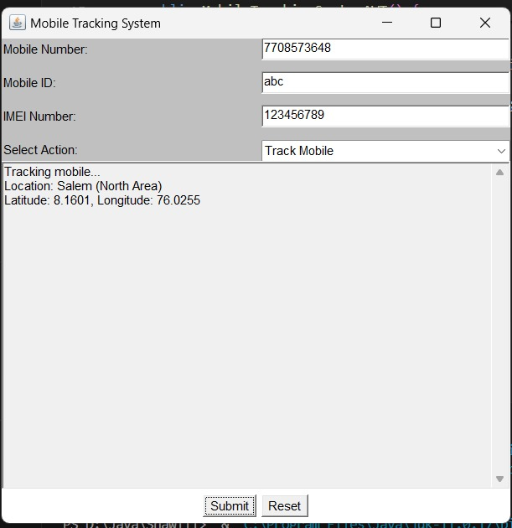
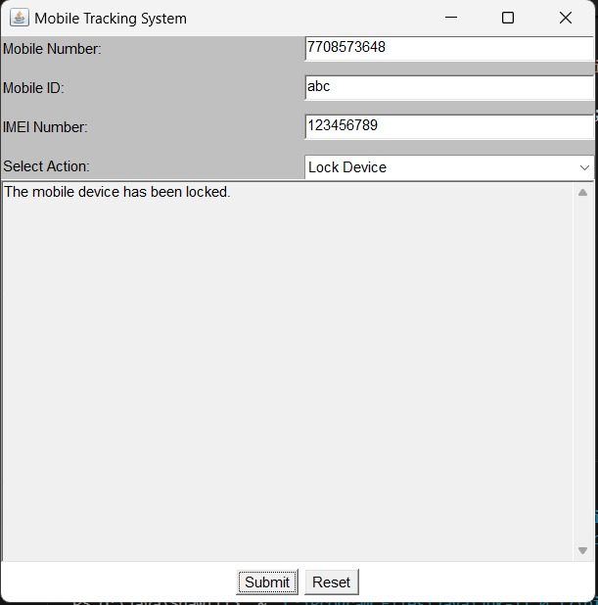
RESULT AND DISCUSSION

Slide 11
ANY QUERIES ?

Slide 12
THANK YOU

